Slide 1
7COM1025 Programming for Software Engineers
7COM1025 Programming for Software Engineers
Java Fundamentals (1)
Dr Hui Cheng
Email: h.cheng2@herts.ac.uk

Slide 2
Module Overview
Assume you have previous programming experience or learnt Java basics before
Recap Java basic programming concepts
Datatypes, variable, operator, loop control, decision making, Strings, Arrays, etc
Teach you advanced programming
Object-oriented: class and object
Inheritance
Polymorphism
Encapsulation

Slide 3
Module Overview
There is no single text book for this module (see book recommendations)
Java™ 7: A Comprehensive Tutorial, by Budi Kurniawan
Java Design Patterns, by Vaskaran Sarcar
Design patterns: elements of reusable object-oriented software, by by Gamma, Erich
All of them can be accessed as library e-books with full-texts
There are plenty of online resources
Online books
Online tutorial
Publicly shared free example codes
You will need to do a lot of practical work
You cannot learn to program the night before your coursework/exam

Slide 4
Module Format
Formal classroom contact comprises
One lecture session on Tuesday starting from week 27 (commencing 27th Jan 20)
One tutorial session and one tutorial session on various days, both starting from week 28 (commencing 3rd Feb), so no practical or tutorial this week.
Theoretical and practical material will be covered during these sessions
The content of the module is defined by the material available on Studynet
Divided into units

Slide 5
How to pass
This is an intense module (5 contact hours per week)
Need to learn theoretical material
Attend the classes
Read books (paper or online), take notes
Programming requires practice
Do the practical session exercises
How to get help
Ask in the classes
Emails
Use the Studynet Discussion forum

Slide 6
Lecture Objectives
In this session, we will review and recap:
What software is?
Computer architecture and programming language
Basic components of a Java program, including methods, special symbols, and identifiers
Primitive data types
How to use arithmetic operators
How a program evaluates arithmetic expressions
How mixed expressions are evaluated
Type casting – converting between types
String type
What an assignment statement is and what it does

Slide 7
What is software ?
A set of instructions which the computer can interpret and execute
instructions are grouped into a PROGRAM
a program may consist of a number of files
a program determines how a computer will respond to requests from an end user
a program is stored on the computer and executed automatically, but may require additional user input
a program needs to be written by a programmer

Slide 8
Von Neumann Architecture
Memory:
instructions + data
Results of operations
Instructions and data
Arithmetic and Logic Unit
Control Unit
I/O
Central Processing Unit

Slide 9
Fetch-Execute Cycle
The von Neumann architecture continuously fetches instructions from the memory, and then executes them.
The Central Processing Unit (CPU) has a program counter (PC), pointing to the next instruction in memory.
initialise PC
repeat forever
fetch instruction from memory at PC
increment PC to point to next instruction
decode the instruction
execute the instruction

Slide 10
Programming languages
Writing machine code is tedious and error-prone
Fortunately, we now have :
programming languages in which to write instructions, in a language we can understand
programs (compilers/interpreters) to translate our program into machine code
each language has its own translating program/s
a programming language is a "formal" languages with strict rules
rules in one language may/will not apply in another
Our program will work as long as we:
write programs using correct syntax (source code)
can transform our program into an executable one
run the executable program (object code)

Slide 11
Programmers and End-Users
students perform as both programmer & end user
Program code
programming
Programmer
compile
Executable Program
run
End User

Slide 12
Programming languages
are very formal languages with:
set of keywords which have special meanings
rules on how statements are constructed (syntax)
ways of specifying : data , instructions
ways of specifying the order in which instructions are to be executed by the computer at runtime
require programmers to stick to their rules
if programmers do not stick to the rules, the translating software (compiler) will not be able to translate the program into machine code.

Slide 13
Characteristics
Java shares features with many others
All programming languages have ways to specify:
instructions - what to do
data - what to do it to
control - what order to do it in
Many also have ways of building complex components from simpler ones - something humans do all the time
Each programming language is designed to solve a type of problem and has its own way of looking at things

Slide 14
Abstraction
Programmers are not just interested in solving a specific problem
convert £10 into euros, design a web page for the Student's Union, add 4 + 7
Programmers are interested in designing solutions to classes of problems
a currency converter, a web page template selector, add any two/set of numbers
A good programmer tries to design programs which will work even when the details of a problem change

Slide 15
Program = Instructions + Data
A program in a programming language is
a list of instructions .....
which operate on data values ...
in a specified order
to carry out some task or solve a problem whose requirements are specified (e.g by a customer)
Programs are like recipes or instruction manuals
do something .. <instruction> … to… <data>
sometimes we process small bits of data, sometimes whole packages of data

Slide 16
Writing a program
Computer programs have to be written accurately in order to work
Computers can’t guess what you mean
May appear to be clever
Actually do the most basic things very fast (very very very fast) and completely accurately
Programs that we write must be free from errors

Slide 17
Writing Programming Code
A program written in a programming language contains:
syntax - rules about how and in what order some things need to be written
keywords - have a special meaning in the language and can't be used for anything else
operators and separators - symbols which have a special purpose
e.g. { } + = ( ) , ; .
identifiers - names of things (variables and functions); which you will need to make up
comments - text ignored by the computer

Slide 18
Program and programming
Computer program: a sequence of statements whose objective is to accomplish a task
Programming: process of planning and creating a program using a specific language
We need to understand the syntax and semantics of any language before we can use it
Syntax is about the structure or the grammar of the language. It answers the question: how do I construct a valid sentence?
Semantics is about the meaning of the sentence. It answers the questions: is this sentence valid? If so, what does the sentence mean?

Slide 19
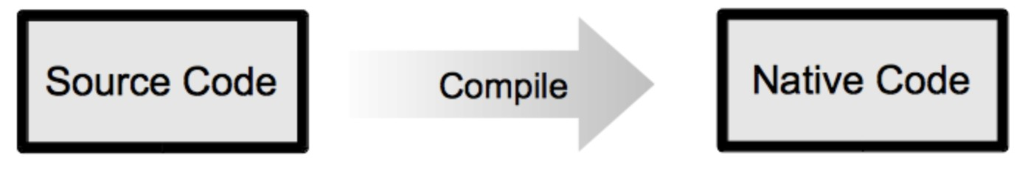
Traditional Programming Paradigm
Image from Java™ 7: A Comprehensive Tutorial

Slide 20
Java works everywhere
Java Source Code
e.g. Counter.java
compile
Java Byte Code/Class File
e.g. Counter.class
interpret
IE
JVM
PC
Mac
JVM
JVM
PDA
JVM
JVM

Slide 21
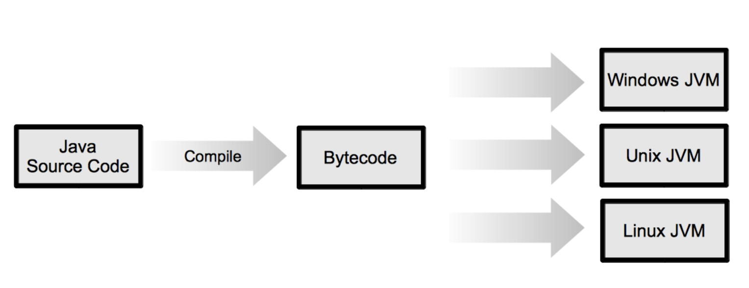
Java programming model
Image from Java™ 7: A Comprehensive Tutorial

Slide 22
A Basic Java Program
Let’s have a look at a basic Java program…
Sample Run:
My First Java Program
The sum of 2 and 3 = 5
7 + 8 = 15

Slide 23

The Basics of a Java Program
MyJavaProgram.exe
Java program: a collection of classes
Identified with the keyword class
Enclosed by curly brackets {}
Represents an object
There is a main method in every Java application program
Represent the entry point into the program
Also enclosed by curly brackets {}
Classes can have many methods but only one main method
A number of Statements made up of tokens
A programming token is the basic component of source
code.
public static void main MyJavaProgram(string[] args) {
// run statements
}

Slide 24
The Basics of a Java Program (cont)
The program above also includes some comments
Comments are written by the programmer (you) to help understand the program
Comments are not used by the computer and omitted during compilation
It is essential and good practise to properly comment your code as you go
There are single-line comments (start with //)
And there are multiple-line comments
Starts with /*
Ends with */

Slide 25
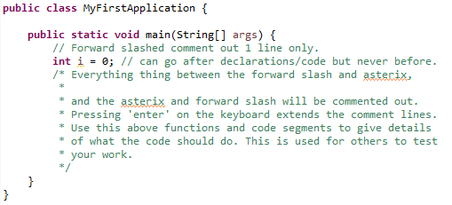

Slide 26
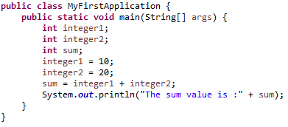
Java Statements
Statements comprise of a variety of tokens which can be constants, identifiers, operators, reserved words, and separators.
We need to understand the syntax and the semantics of Java statements in order to write programs.

Slide 27
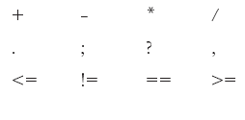
The following are several of Java’s Special Symbols; they have a predetermined meaning in Java.
Line 1 represent mathematical symbols (add, subtract, etc)
Line 2 consists of punctuation
Line 3 contains comparison symbols
Less than or equal too <= my age is less than or equal to 29.
Not equal too != (the ‘!’ means ‘not’, the boy is NOT 15, boy != 15).
Equal too == the boys age is equal to 15.
Greater or equal too >= the boys is either 15 or older.
There are others, e.g. (=) is the assignment symbol!

Slide 28
Reserved Keywords
int, float, double, char
void, public, static, throws, return
Full list is found here
https://docs.oracle.com/javase/tutorial/java/nutsandbolts/index.html
Like special symbols, can only be used as intended by the programmers whom wrote the Java library.
Tell the compiler/interpreter how to handle the commonly used data format.
Reserved words are normally highlighted differently in Java IDE such as NetBeans.

Slide 29
Java Identifiers
User defined reserved keywords
Variables
Class names
Function / method names
Consist of
Letters, digits, underscore, and dollar sign $
All identifiers should begin with a letter, dollar sign ( $ ) or an underscore ( _ ).
Can not start with a number, and can not have white space.

Slide 30
Illegal Identifiers
Illegal Identifier | Description
Employee Salary | There can be no space between Employee and Salary.
Hello! | The exclamation mark cannot be used in an identifier.
One+two | The symbol ‘+’ cannot be used in an identifier.
2ND | An identifier cannot begin with a digit.

Slide 31
Java Statements
Reserved words
Special Symbols
Identifiers

Slide 32
Data Types
Java has a set of basic data types and operations that can be performed on them
Integral: which deals with integers, or numbers without a decimal part (and characters)
char, byte, int, short, long
Floating-point: which deals with decimal numbers
float, double
Boolean: which deals with logical values

Slide 33
Values & Memory Allocation for Integral Data Types
Data Type | Values | Storage (in bytes)
char | 0 to 65535 (= 2¹⁶ – 1) | 2 (16 bits)
byte | -128 (= -2⁷) to 127 (=2⁷ - 1) | 1 (8 bits)
short | -32768 (= -2¹⁵) to 32767 (= 2¹⁵ - 1) | 2 (16 bits)
int | -2147483648 (= -2³¹) to 2147483647 (= 2³¹ - 1) | 4 (32 bits)
long | -922337203684547758808 (= -2⁶³) to 922337203684547758807 (= 2⁶³ - 1) | 8 (64 bits)

Slide 34
Primitive Data Types
Char: (character) can be used to represent any single character
Letter, digits, special symbols enclosed in single quotation marks ' '
'a', 'A', '5', '*', ' ', etc
Floating-point: data types
Floating-point numbers are numbers that have fractional parts (usually expressed with a decimal point). You should use a floating-point type in Java programs whenever you need a number with a decimal, such as 19.95 or 3.1415.
The precision of a floating-point value indicates how many significant digits the value can have following its decimal point
float: precision = 6 or 7 (4 bytes)
double: precision = 15 (8 bytes)
boolean: two values (1 bit!)
true
false

Slide 35
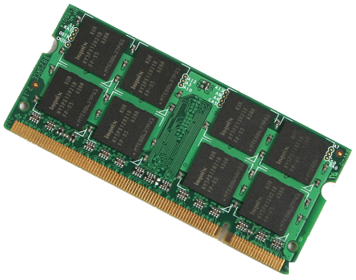
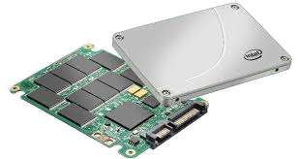
Making a variable
In order to make (declare) a variable in Java, we need to know:
Its datatype (int, short, char, boolean, etc, etc)
What we want to call it (must be a valid Java identifier)
This reserves a labelled space in memory that we can store and retrieve data (of the specified type) in while the variable is in scope
(more later in the module)

Slide 36
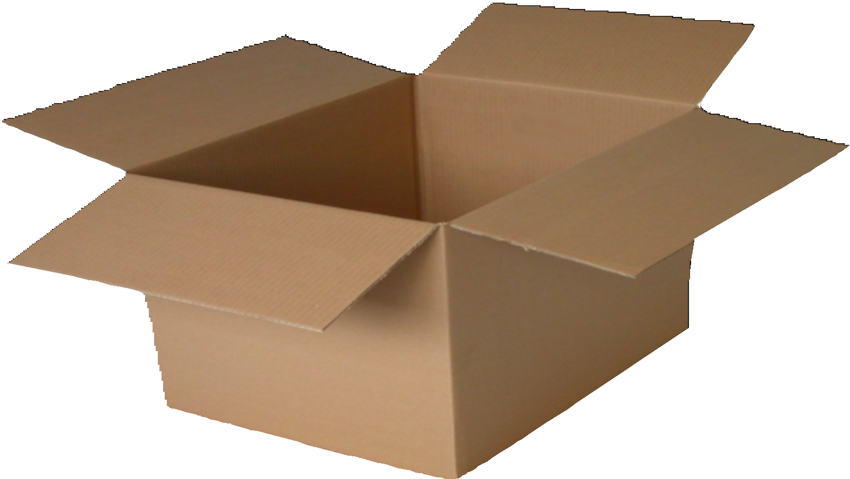
Variables

Slide 37
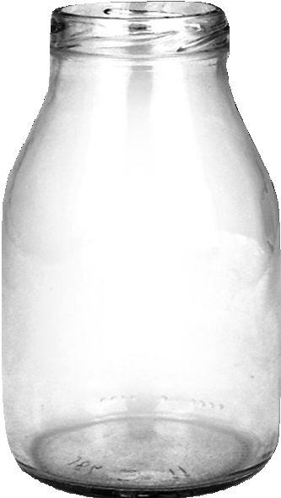
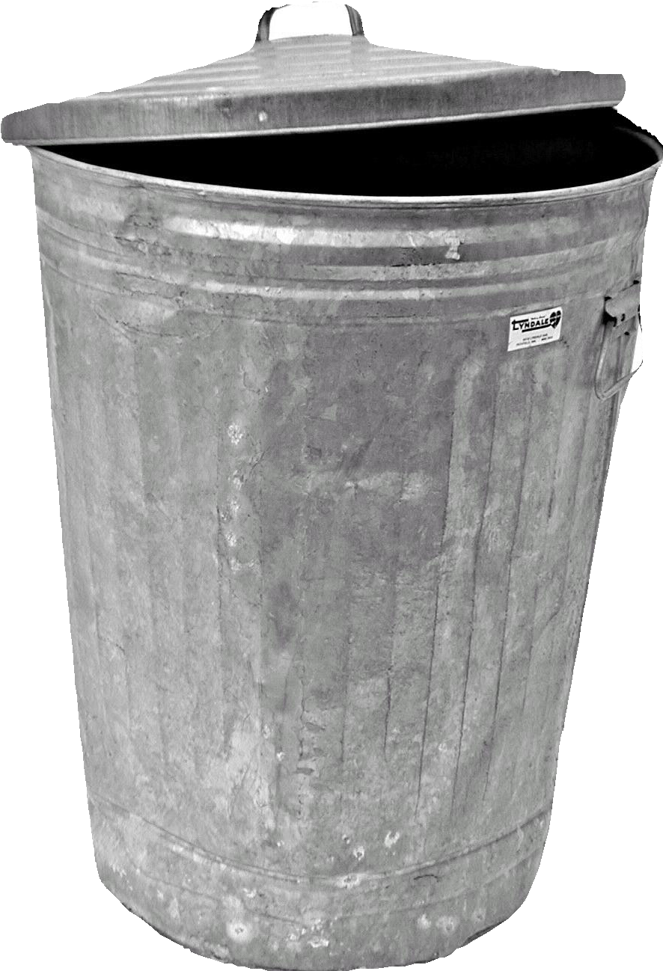

Types?

Slide 38
Variables
Variables are containers

Slide 39
Variables
Variables are containers
Variables have a type (diﬀerent containers for diﬀerent objects)
int

Slide 40
Variables
Variables are containers
Variables have a type (diﬀerent containers for diﬀerent objects)
Variables have a name (unique identifier)
int var

Slide 41
Variables
Variables are containers
Variables have a type (diﬀerent containers for diﬀerent objects)
Variables have a name (unique identifier)
Variables contain “instances of the type they are created for”
int var=3;

Slide 42
Example variables
int numPasses;
boolean feesPaid;
char grade;
These are all valid variable declarations:
These are NOT! But why are they wrong?
int void;
boolean 2place;
char pass grade;
Programmers love short-hand writing.
Lazy but efficient
Saves typing lots

Slide 43
Constants
Sometimes we just want to represent a single value, these are called constants
e.g. integer1 = 10; //10 is a constant
Integer constants, or integers: 23 and -67
Floating-point constants, floating-point numbers:
12.34
25.60
Character constants, or characters: 'a' and '5'

Slide 44
Combining Constants and Variables
For now, we’ll hardcode values (i.e. constants) into our variables; e.g.
int numPasses = 42;
boolean feesPaid = false;
char grade;
grade = 'B';
grade = 'A';
What happens here?
char grade;
grade = 'B';
System.out.println(grade);
grade = 'A';
System.out.println(grade);
Does this help to explain?

Slide 45
Arithmetic Operators and Operator Precedence
To operate on the numeric types, we have five arithmetic operators
+ addition
- subtraction
* multiplication
/ division
% mod (remainder) (5 mod 2 = 1) because 2 goes into 5 twice.
Unary operator: operator that has one operand
+ or – can be unary (positive or negative)
Binary operator: operator that has two operands
+, -, *, /, % must be binary
For example: 3 − −2

Slide 46
Order of Precedence
Java has rules over the order of precedence of operators:
1. * / % (same precedence)
2. + - (same precedence)
Operators in 1 have a higher precedence than operators in 2
When operators have the same level of precedence, operations are performed from left to right
We can use parenthesis to avoid confusion here ()
Think Maths and BODMAS / BIDMAS
Brackets, Orders, Division, Multiplication, Addition, Subtraction.
Brackets, Indices, Division, Multiplication, Addition, Subtraction.

Slide 47
Numeric Expressions
Java can handle a range of expressions:
Integral expressions (all operands are whole number constants or variables)
All operands are integers
2 + 3 * 5
3 + a – b / 7
a + 2 * (b – z) + 18
Floating-point or decimal expressions
All operands are floating point numbers
12.8 * 17.5 – 34.50
x * 10.5 + y - 16.2

Slide 48
Mixed Expressions
Integral Expression
Mixed expressions
Operands of different types
2 + 3.5
6 / 4 + 3.9
Integer operands yield an integer result; floating-point numbers yield floating-point results
If both types of operands are present, the result is a floating-point number
This is called implicit type coercion (promotion)
The integers are promoted to floating point numbers
Precedence rules are still followed!
2 + 3.5
Floating Expression

Slide 49
Explicit Type Conversion (Casting)
We can make an expression produce a data type we want by casting
Used to avoid implicit type coercion
Expression evaluated first, then type converted
Involves a possible loss of data, so needs explicitly stating
Syntax
(dataTypeName) expression
Examples
(int)(7.9 + 6.7) = 14
(int)(7.9) + (int)(6.7) = 13

Slide 50
The class String
If we want to manipulate more than one character at a time, we use strings
String
Sequence of zero or more characters (char)
Enclosed in double quotation marks, e.g. "Hello"
Null or empty strings have no characters
Numeric strings consist of integers or decimal numbers
We can think of strings as a list of chars
Length is the number of characters in a string
Each char has a specific position in the list (starting at 0)!
String temp = “I have been made.”; // not Null
String temp; // this is still empty memory address.

Slide 51
Strings and the Operator ‘+’
Confusingly, the + operator is also used to concatenate two Strings or a String and a numeric value or character
Example
string variable1 = "The sum = " + 12 + 26;
After this statement executes, the String assigned to variable1 is:
"The sum = 1226"

Slide 52
Strings and the Operator + (continued)
Now consider the following statements:
int num1 = 12;
int num2 = 26;
str = "The sum = " + (num1 + num2);
In this statement, because of the parentheses, you first evaluate num1 + num2
num1 and num2 are both int variables
num1 + num2 = 12 + 26 = 38
After this statement executes, the String assigned to str is:
"The sum = 38"

Slide 53

Problem
A new heating system is being installed in the Learning Resource Centre. For the set-up phase, the technicians need to know how the temperature changes during a time frame of 24 hours.
We have been provided a Raspberry PI with a sensor of temperature able to record a value every hour.

Slide 54
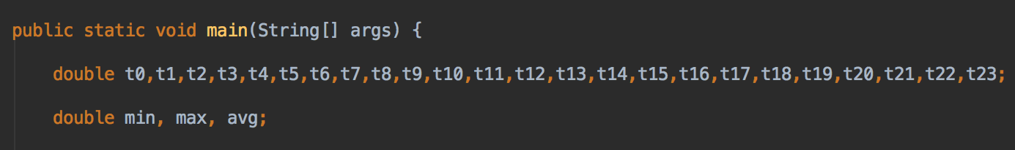
24 values, 24 variables?

Slide 55
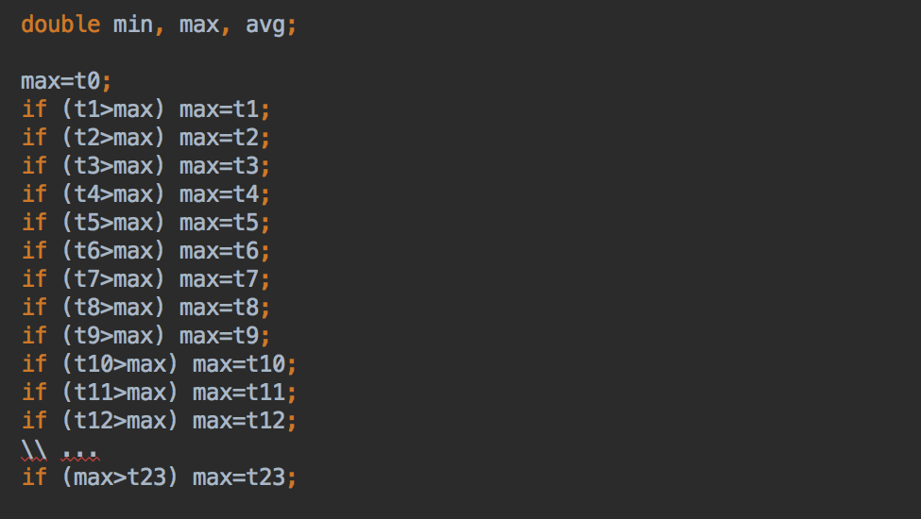
Max temperature?

Slide 56
Arrays
Arrays are multiple containers
Arrays have a type
Arrays have a name (unique identifier)
Arrays contain “a finite number of multiple instances of the type they are created for”
The elements in the array can be accessed using an index
int[] ar=new int[4];

Slide 57
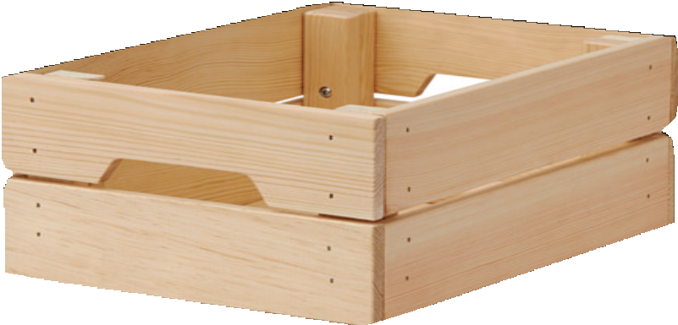
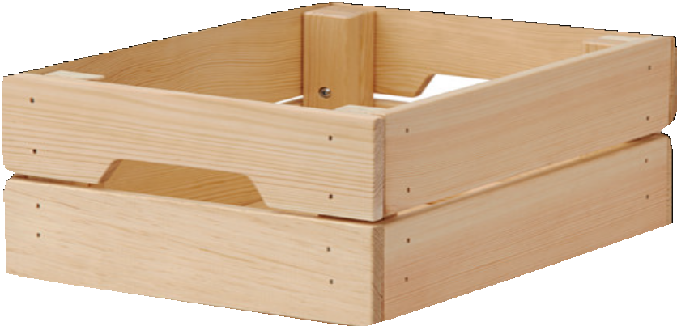

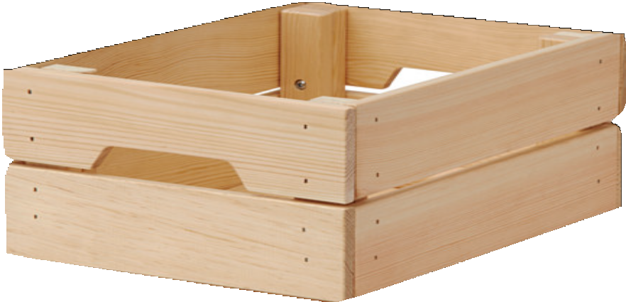
Array!

Slide 58
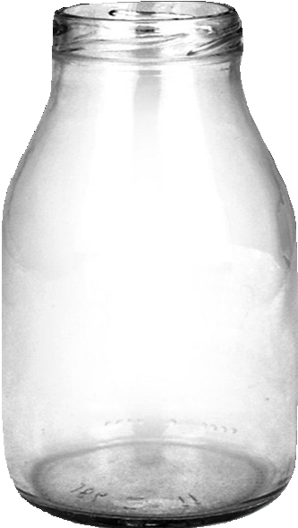
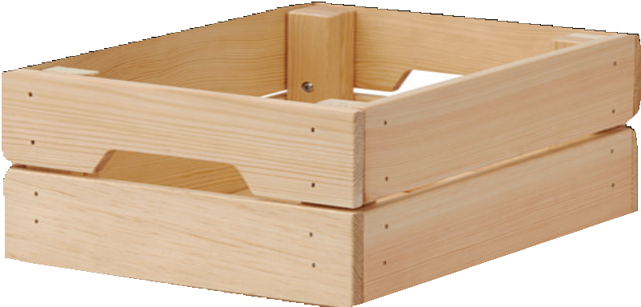
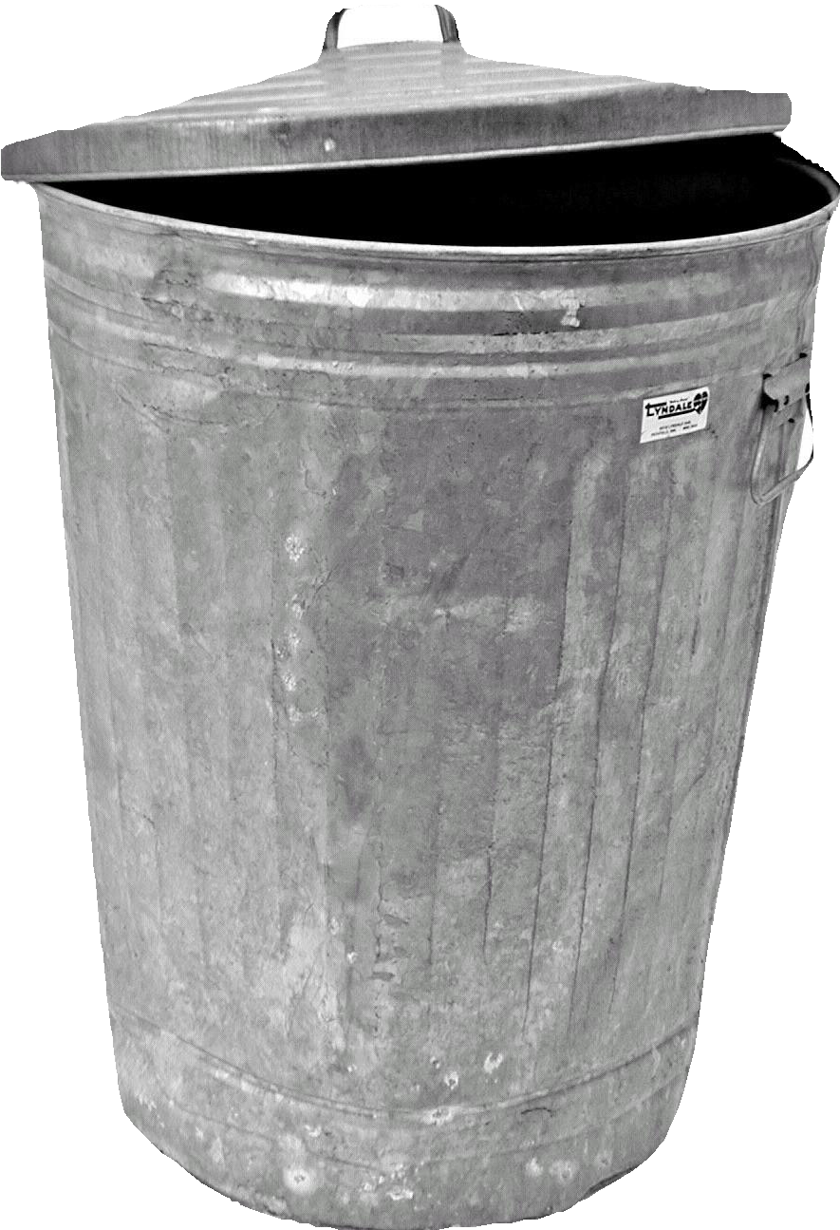

Not Array!

Slide 59
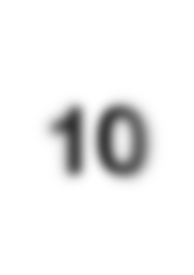
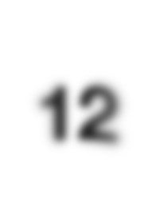
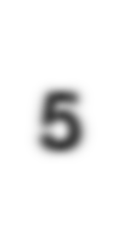
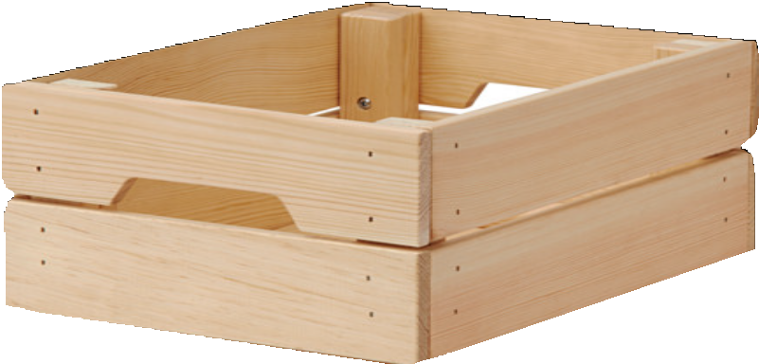
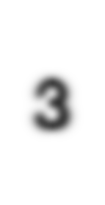



Array
10
ar
12
5
3
0
1
2
3

Slide 60
Array
10
ar
12
5
3
0
1
2
3
indexes

Slide 61
Creating arrays
int[] ar=new int[4];

Slide 62





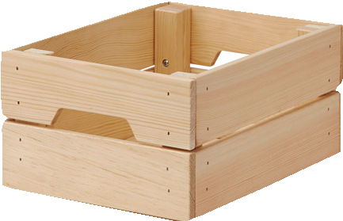
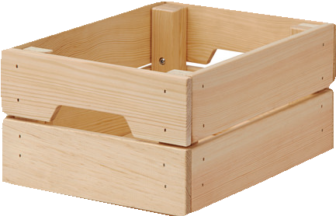
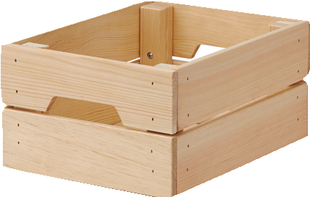
Creating arrays
ar 0
int[] ar=new int[4];
0
0
0
ar 2
8
int[] ar={2,8,34,14};
34
14

Slide 63
Creating arrays 2
int s=4;
int[] ar=new int[s];

Slide 64
Accessing arrays
ar 0
0
int[] ar=new int[4];
0
0

Slide 65




Accessing arrays
ar 0
0
int[] ar=new int[4];
0
0
ar[0]=12;
ar
12
0
0
0

Slide 66
Accessing arrays
ar 0
0
int[] ar=new int[4];
0
0
ar[0]=12;
ar[1]=15;
ar
12
15
0
0

Slide 67
Accessing arrays
ar 0
0
int[] ar=new int[4];
0
0
ar[0]=12;
ar[1]=15;
ar[2]=25;
ar
12
15
25
0

Slide 68
Accessing arrays
ar 0
0
int[] ar=new int[4];
0
0
ar[0]=12;
ar[1]=15;
ar[2]=25;
ar[3]=23;
ar
12
15
25
23

Slide 69
Length
ar[0]=12;
ar[1]=15;
ar[2]=25;
ar[3]=23;
ar
12
15
25
23

Slide 70
Length
ar[0]=12;
ar[1]=15;
ar[2]=25;
ar[3]=23;
ar
12
15
25
23
System.out.println(ar.length);

Slide 71
Length
ar[0]=12;
ar[1]=15;
ar[2]=25;
ar[3]=23;
ar
12
15
25
23
System.out.println(ar.length);
4

Slide 72

Checkpoint

Slide 73
Declare and initialise an array d of double, length 5
Change the value of the 4th element to “3.4”
Print the length of the array using the keyword “length”

Slide 74
Declare and initialise an array d of double, length 5
double d=d[5];
double[ ] d=new
double( ) d=new
double[5];
[5];

Slide 75
Declare and initialise an array d of double, length 5
double d=d[5];
double[ ] d=new
double( ) d=new
double[5];
[5];

Slide 76
Change the value of the 4th element to “3.4”
A. d[5]=3.4;
B. d=new
double[3.4];
C. d[3]=3.4;

Slide 77
Change the value of the 4th element to “3.4”
A. d[5]=3.4;
B. d=new
double[3.4];
C. d[3]=3.4;

Slide 78
Print the length of the array using the keyword “length”
System.out.println(d.length);
System.out.println(double.length);
System.out.println(length(d));

Slide 79
Print the length of the array using the keyword “length”
System.out.println(d.length);
System.out.println(double.length);
System.out.println(length(d));

Slide 80
Remember…
Arrays are multiple containers
Arrays have a type
Arrays have a name (unique identifier)
Arrays contain “a finite number of multiple instances of the type they are created for”
The elements in the array can be accessed using an index
type[] name=new type[n];

Slide 81
Summary
In summary, today we have:
introduced the module overview
introduced software, computer architecture, and programming languages
some Java fundamental knowledge

